Slide 1
Lead scoring case study

Slide 2
Team:
Likhitha C
Wahid
Venkata Koushik Akella

Slide 3
Problem statement:
X Education is an organization which provided online courses for industry professional the company marks its courses on several popular websites like google
X Education company needs help to identify the most promising leads.
This has to be done by building a Logistic regression model that can be trained with the Leads data of the past and then deployed to predict whether a particular lead will lead to payment or not. Each lead has to be given a lead score between 0 and 100 where less score means not a promising lead and vice-versa. the CEO has also given a ballpark target lead conversion rate to be 80%.

Slide 4
Business goal:
The company requires a model to be built for selecting most promising leads
build a logistic regression model to assign a lead score between 0 and 100 to each lead and based on the lead, classify them as hot leads or not so hot leads.
The model is expected to fit certain other problems put forth by the X Education company in the form of a separate word document. fill the solutions to those problems based on the model we get in the end of this analysis.

Slide 5
Strategy:
Importing data
Prepare the data for model budling
Build a logistical regression model
Assign a lead score for each lead
Test the model on train set
Evaluate model by different measure and metrics
Test the model on test set

Slide 6
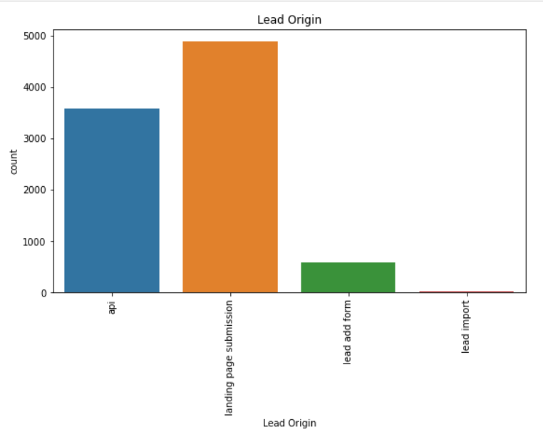
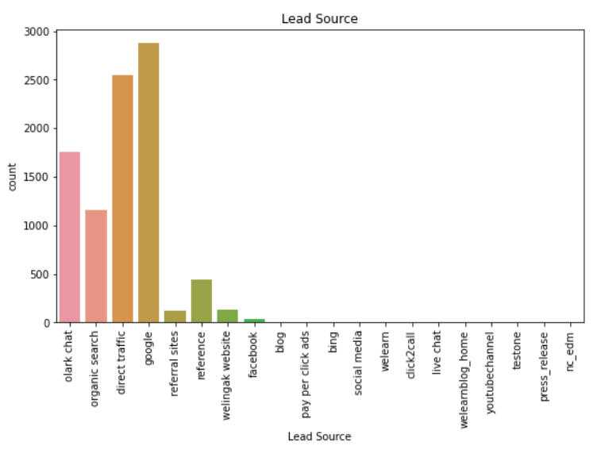
Exploratory data analysis: Categorical Variables

Slide 7
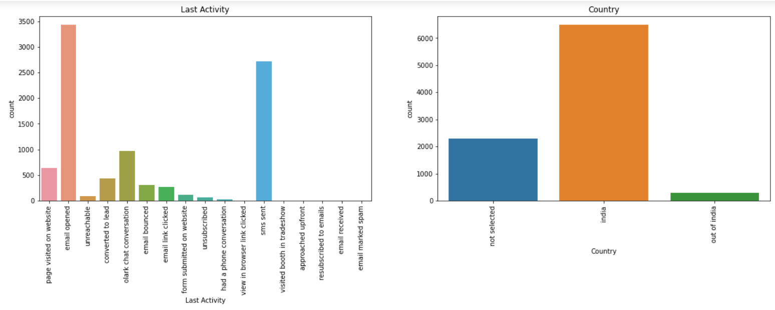

Slide 8
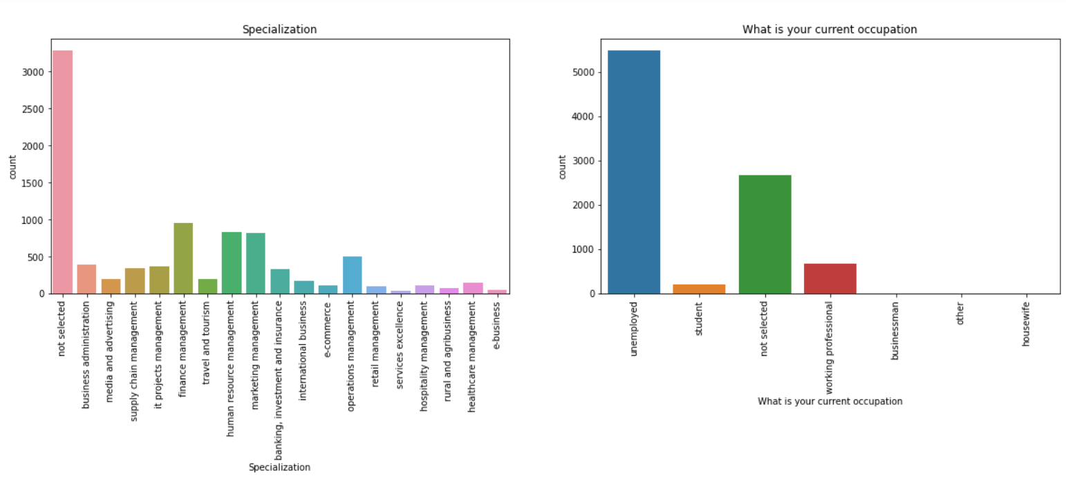

Slide 9
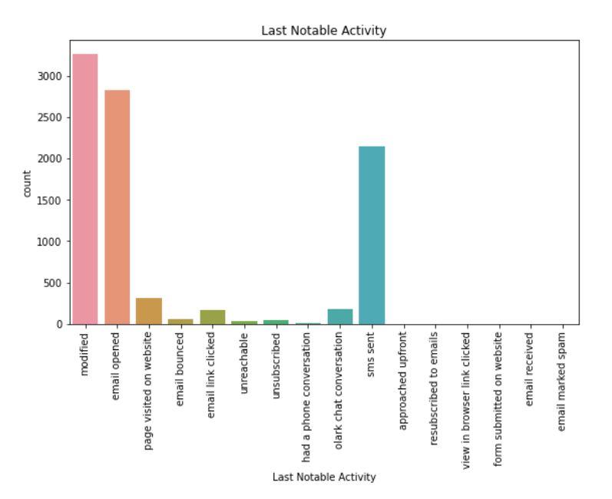

Slide 10
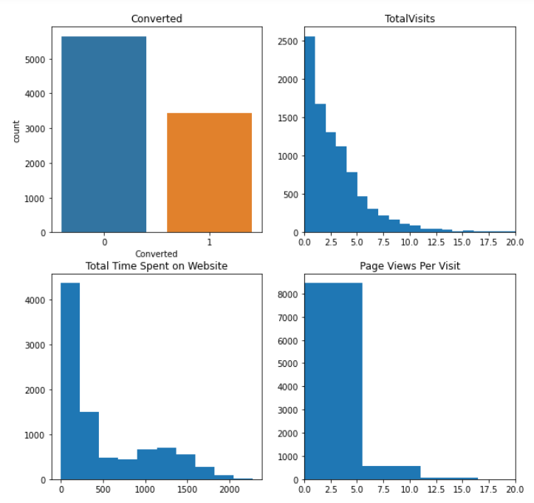
EDA: Continuous Variables:

Slide 11
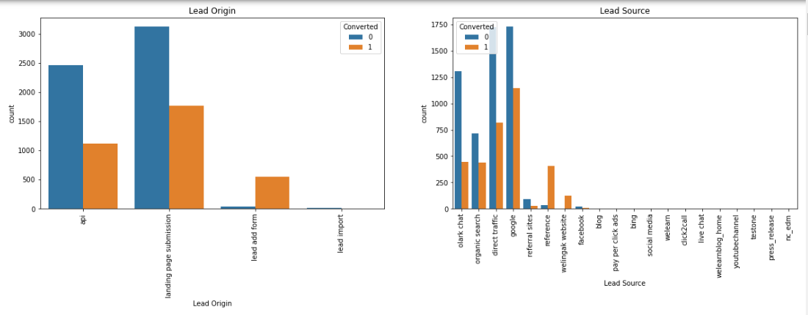
Bivariate Analysis: Categorical Variables against Conversion rate:

Slide 12
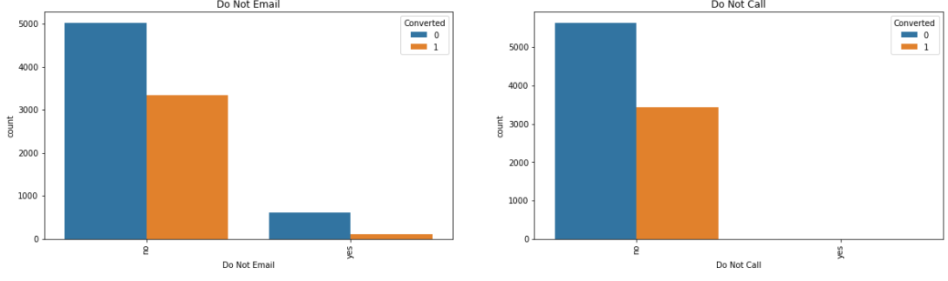

Slide 13
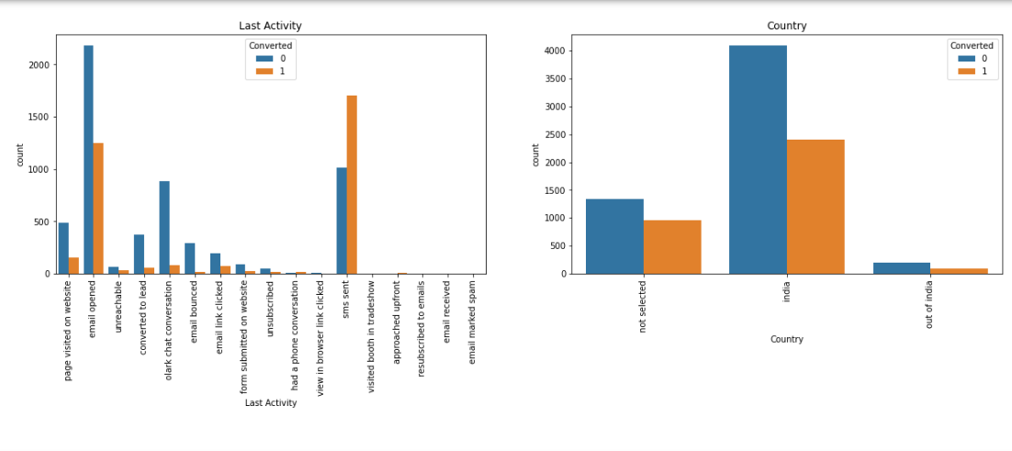

Slide 14
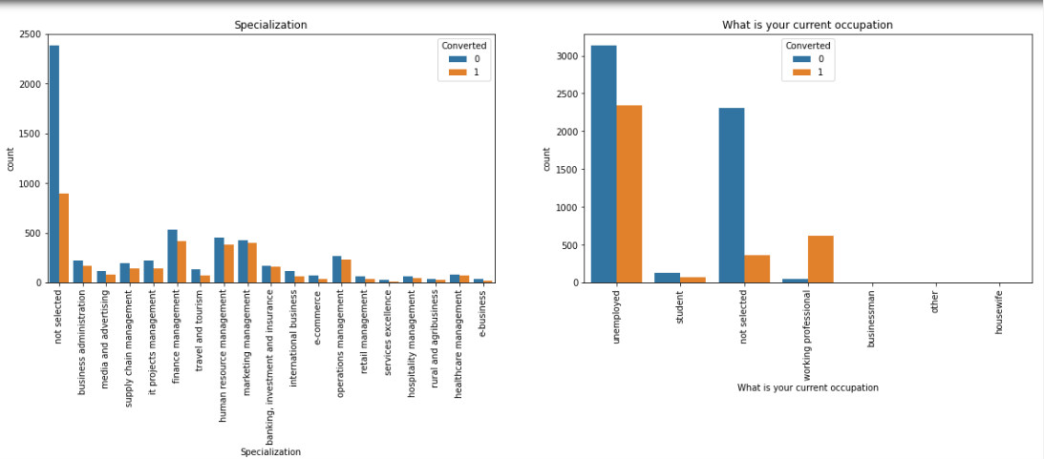

Slide 15
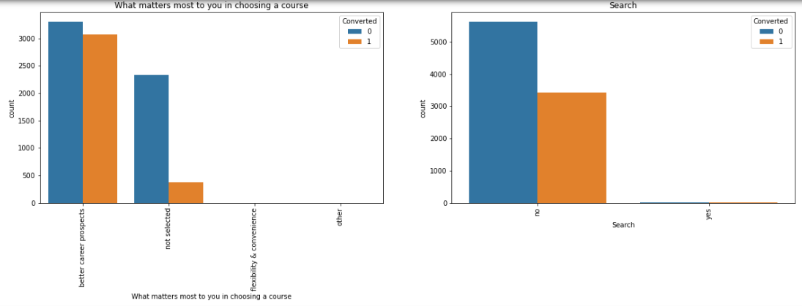

Slide 16
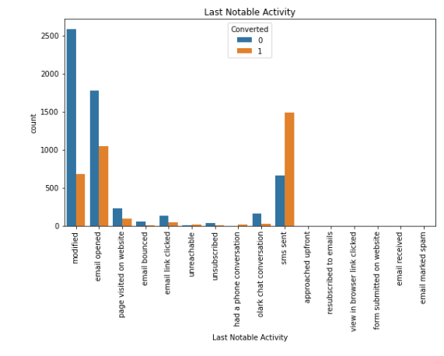

Slide 17
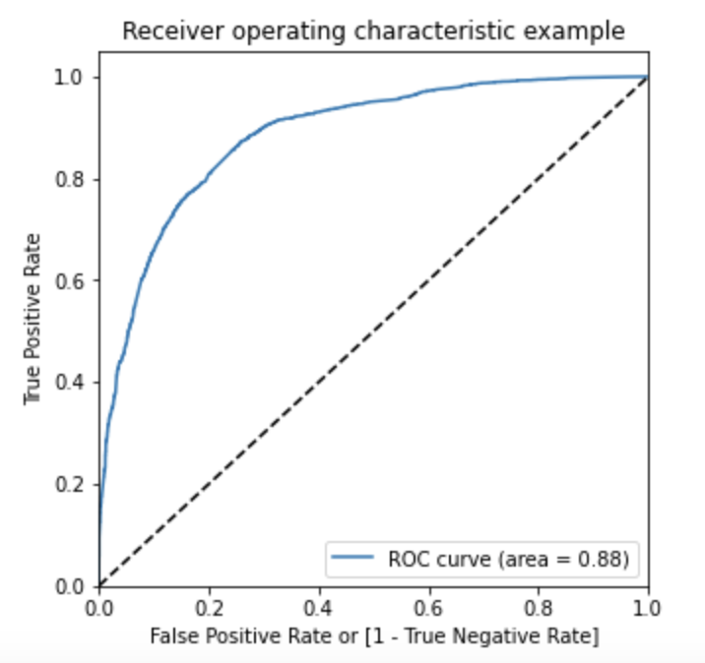
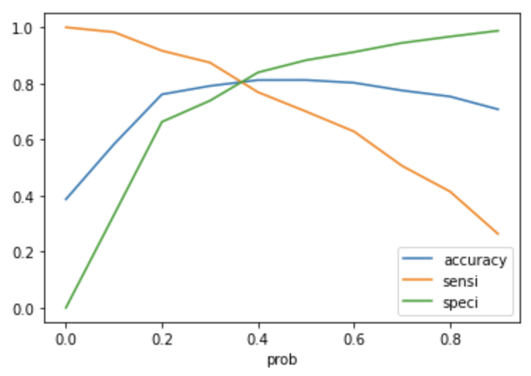
After the EDA, we go ahead with creating dummy variables for categorical variables.
Then we do splitting of the data into train and test sets in 70:30 ratio.
Now we go with building the model. We use RFE for feature selection and then train the model using those features. In this respect, our third model has been finalized as our final model with 80% accuracy.
The ROC curve is as shown in figure which is acceptable. Also the accuracy-sensitivity and specificity tradeoff has given a cutoff of 0.35.

Slide 18
Conclusion:
It was found that the following parameters are effecting the conversion rate of potential hot leads:
The total time spend on the Website.
Total number of visits.
When the lead source was:Google, Direct traffic, Organic search
When the last activity was: SMS, Olark chat conversation
When the lead origin is Lead add format.
When their current occupation is as a working professional.
by focussing on these potential parameters, X Education can focus on these variables to achieve the best conversion rate

Slide 19
Thank you

